Slide 1
Composite Pattern
Structural, Object focused

Slide 2
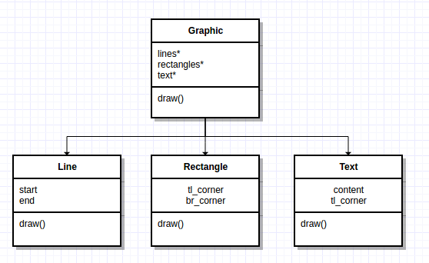
Motivation
Graphics programs allow users to build complex diagrams out of simple primitive components. Imagine the following implementation:
Primitives (line, rectangle, text) each have their own class
More complex graphics are composed of those primitives or other graphics (compositions)
Primitives and compositions are different classes

Slide 3
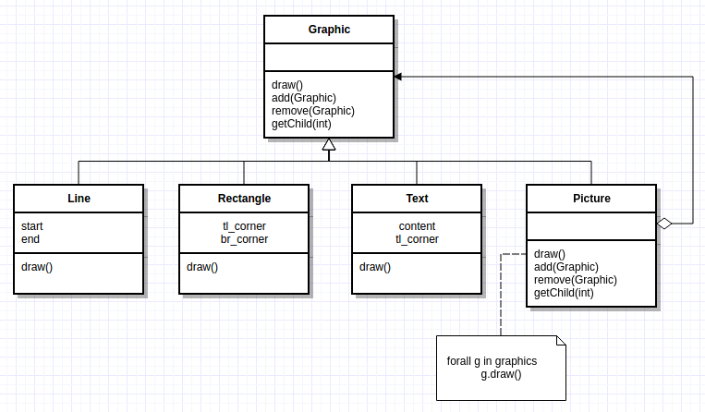
Motivation
However, clients typically treat primitives and compositions the same. Notice the “draw()” function in each class(Coding example: cpp.sh/3qpb )

Slide 4
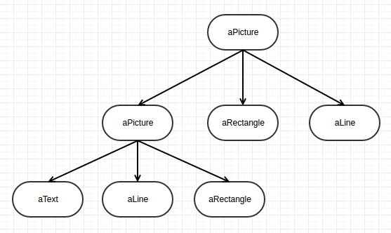
Motivation
Creates a hierarchy of objects using recursively composed Graphic objects

Slide 5
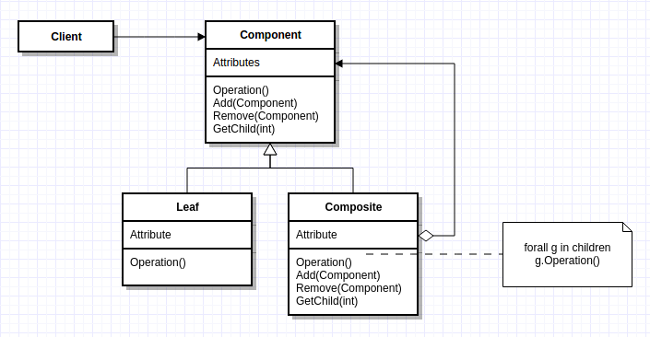
Structure
Component
Declares the interface
default behavior
Leaf
behavior of primitives
Composite
Stores children
Implements child related operations
Client
Manipulates composition through interface

Slide 6
Consequences
Pros:
Defines class hierarchies consisting of primitive and composite objects
Primitive objects can be composed into more complex objects (composites)
Makes client interaction simple. Clients treat composites and primitive the same, using the same interface
Adding additional components (primitives/composites) is straightforward
Cons:
Design is overly general
Harder to restrict components of a composite

Slide 7
Your turn
Design an UML diagram for an organogram of an organization
Employee, Manager

Slide 8
Your turn
Design an UML diagram for a file system that has
File , folder

Slide 9
Example from “Design Patterns: Elements of Reusable Object-Oriented Software”
Erich Gamma
Richard Helm
Ralph Johnson
John Vlissides

Slide 10
Designing A Document Editor
We are designing a “What-You-See-Is-What-You-Get” (or “WYSIWYG”) document editor called Lexi. The document editor can
mix text and graphics freely
Utilize a variety of formatting styles
etc.
Surrounding the document are
pull-down menus
scroll bars,
a collection of page icons for jumping to a particular page in the document
etc.

Slide 11
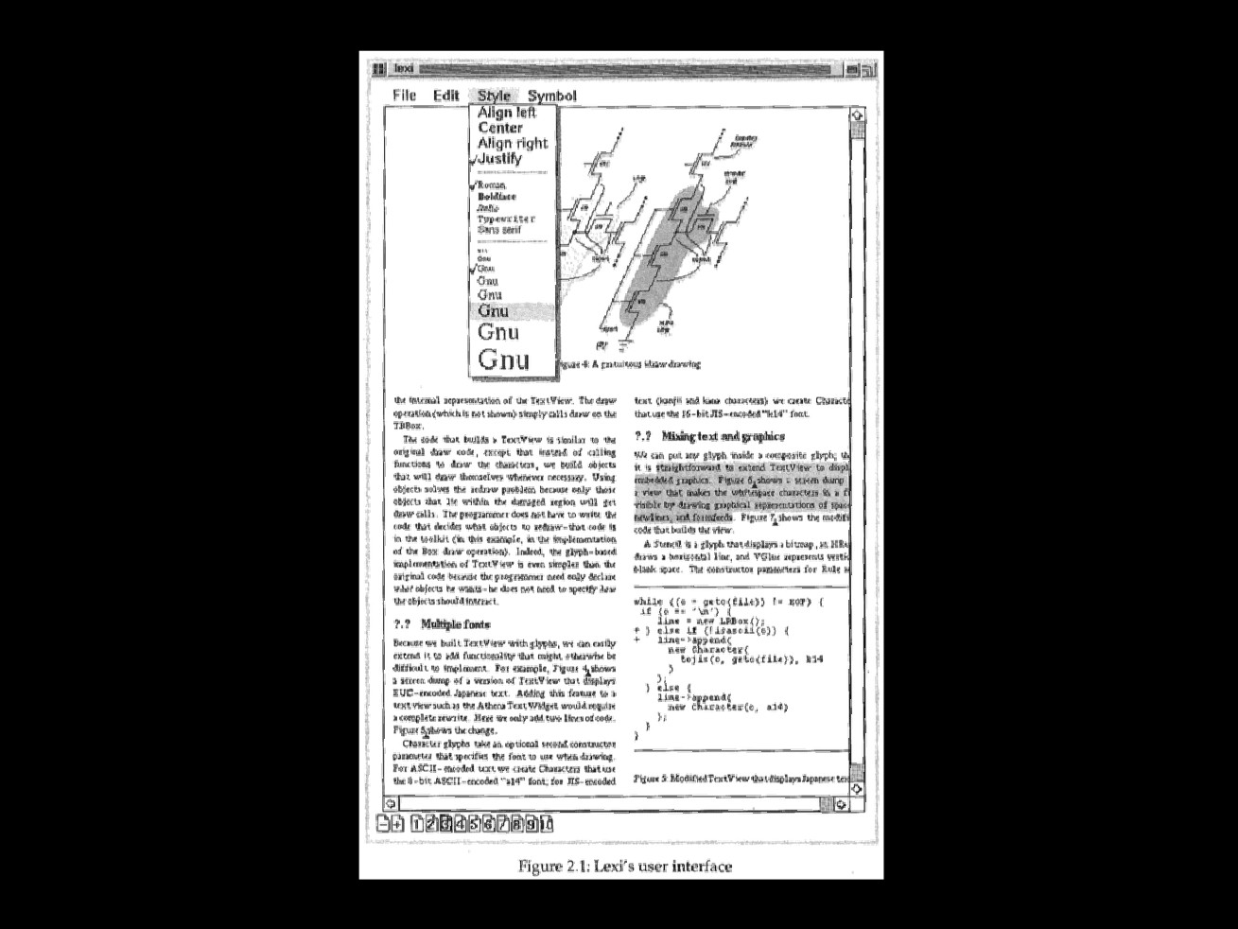

Slide 12
Document Structure
The choice of internal representation for the document affects almost every aspect of Lexi’s design
All editing, formatting, displaying and textual analysis will require traversing the representation
The way we organize the information will impact the design of the rest of the application

Slide 13
Document Structure
A document is ultimately just an arrangement of basic graphical elements such as character’s, lines, polygons and other shapes
Authors often view the document in terms of its physical structure - lines, columns, figures, tables, etc.
Each substructure has substructures of their own
columns with lines, lines with figures, tables with columns and rows, etc.

Slide 14
Document Structure
The internal representation should support the following:
Maintaining the document’s physical structure, that is, the arrangement of text and graphics into lines, columns, tables, etc.
Generating and presenting the document visually
Mapping positions on the display to elements in the internal representation. This lets Lexi determine what the user is referring to when he/she points to something in the visual representation

Slide 15
Document Structure
It should also have the following constraints:
Text and graphics should be treated uniformly
Our implementation shouldn’t have to distinguish between single elements and groups of elements in the internal representation
We will still need to analyze text for things like spelling errors and potential hyphenation points

Slide 16
Recursive Composition
A common way to represent hierarchically structured information is through a technique called recursive composition.
Increasingly complex elements are built out of simpler ones through a common base class using inheritance
Sets of characters and graphics can be tiled into rows, and groups of rows in columns, and groups of columns in pages, etc.

Slide 17
Recursive Composition
The physical structure can be represented by devoting an object to each important element
These elements are not always visible elements (characters, graphics, etc.) but also invisible structural elements (rows, columns, pages, etc.)
Invisible structural elements will be made up of collections of visible elements, or collections of other invisible elements in a tree like hierarchical structure

Slide 18
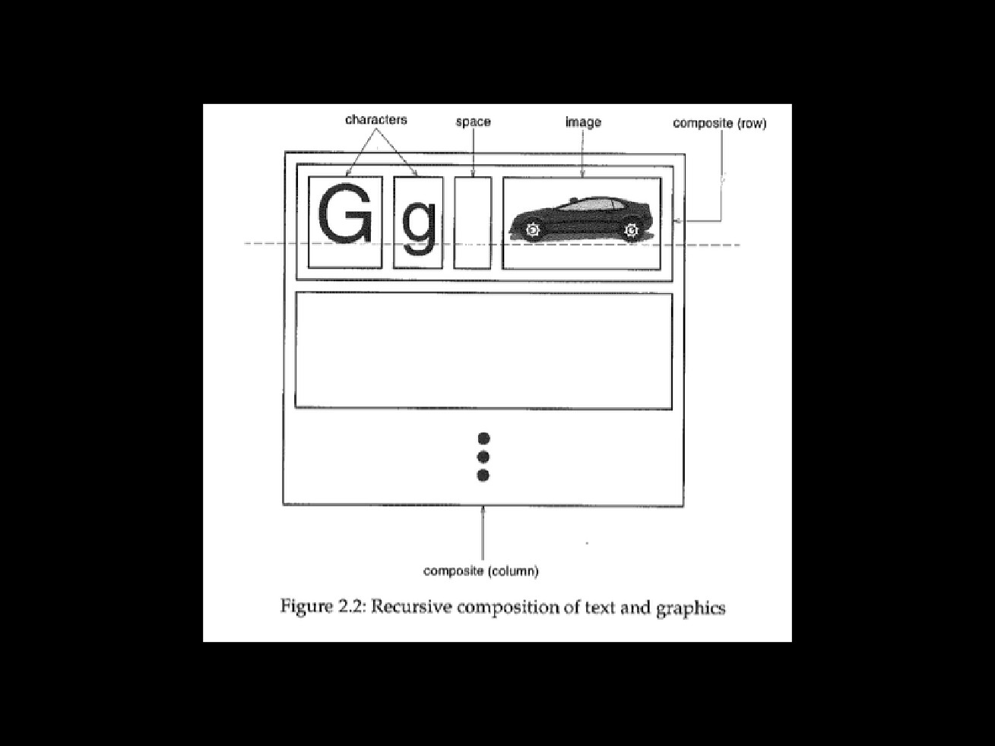

Slide 19
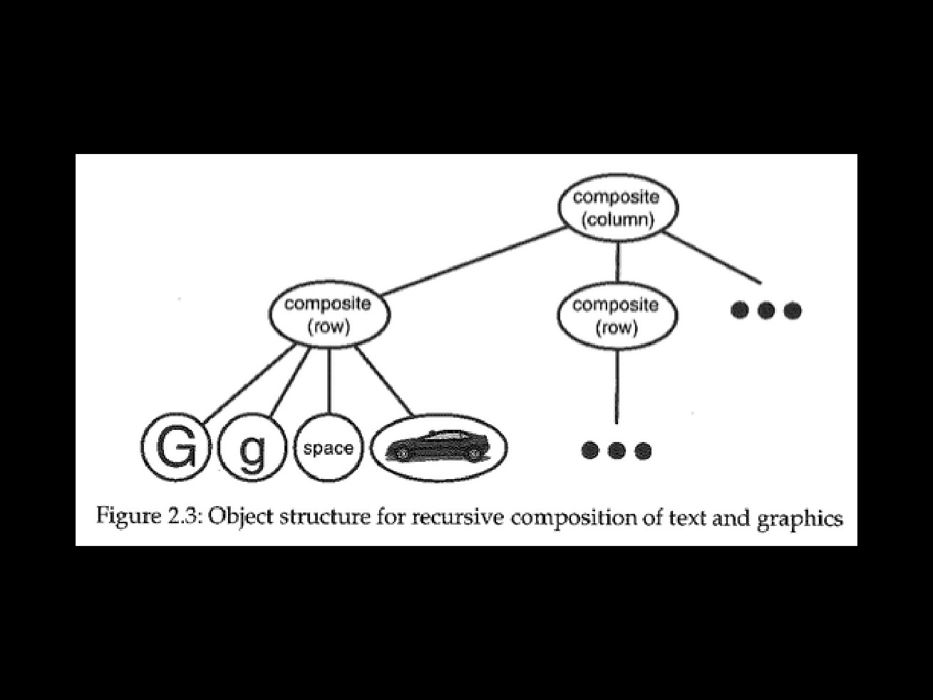

Slide 20
Structure
We can categorize these visible and invisible structural elements into the following types
Characters and/or graphics make up the leaf or primitives
Rows, columns or pages make up the composites
These form a tree-like hierarchy

Slide 23
Glyphs
We start with an abstract base class for all objects that can appear in a document structure called Glyph
Its subclasses define both
base graphical elements (characters, graphics; Leaf or primitives), and
Structural elements (rows, columns, pages; Composites)
What common interface(s) make sense for all of these objects to share in common?

Slide 24
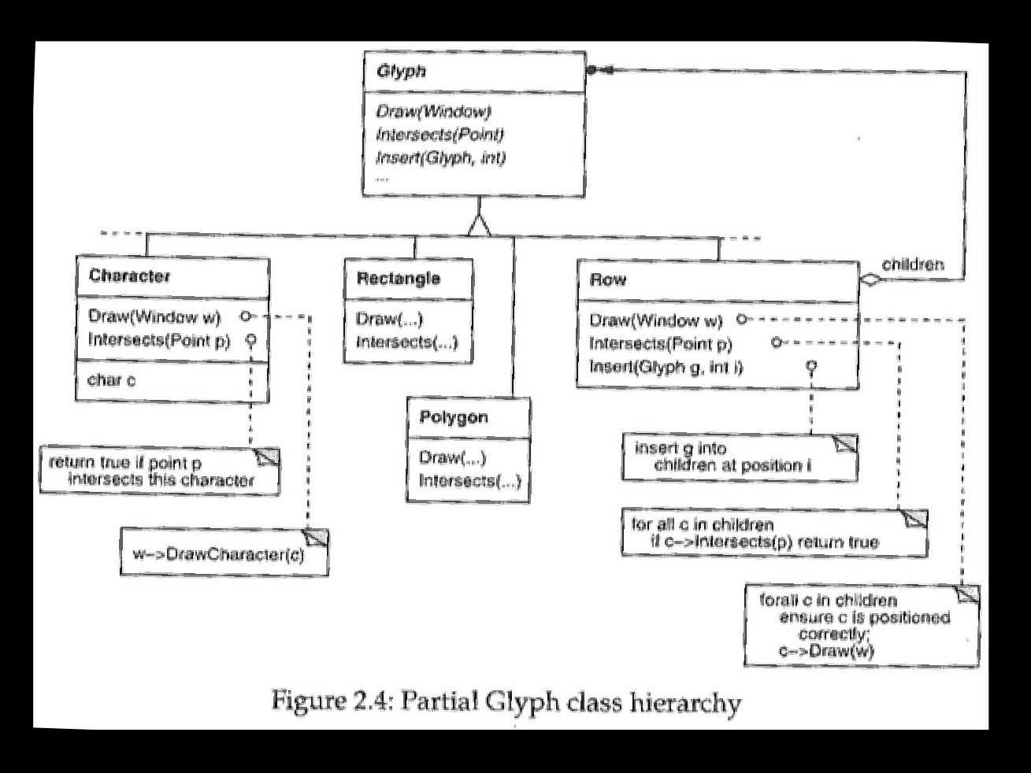

Slide 25
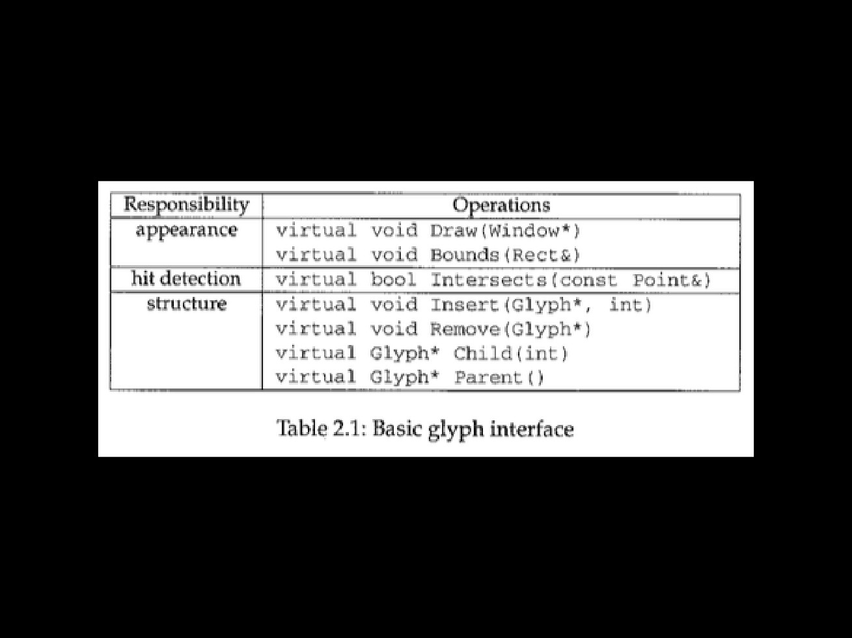

Slide 26
Glyphs
Glyphs have three basic responsibilities
They know how to draw themselves
They know what space they occupy
They know their children and parent

Slide 27
Glyphs
Each Glyph subclass will redefine the draw operation to render themselves onto a Window (more on Window later)
A Rectangle subclass of Glyph might redefine draw like this: Void Rectangle::draw(Window* w) { w->drawRect(x0,y0,x1,y1); }
This would draw a rectangle on the screen from the upper left (x0,y0) to the lower right (x1,y1) using the Rectangles internal variables

Slide 28
Glyphs
A parent Glyph often needs to know how much space a child glyph occupies, for example, to arrange it and other glyphs in a line so that none overlap
The Bounds operation returns the rectangular area that the glyph occupies
It returns the opposite corners of the smallest rectangle that contains the glyph (bounding box)
Glyph subclasses redefine this operation to return the rectangular area in which they draw

Slide 29
Glyphs
The Intersects operation returns whether a specified point intersects the glyph
Whenever the user clicks somewhere in the document, Lexi calls this operation to determine which glyph or glyph structure is under the mouse
The Rectangle class redefines this operation to compute the intersection of the rectangle and the given point, and return if their is or is not an intersection

Slide 30
Glyphs
Because glyphs can have children, we need a common interface to add, remove and access those children
For example, a Row’s children are the glyphs it arranges into a row
The Insert operation inserts a glyph at a position specified by an integer index
The Remove operation removes a specified glyph if it is indeed a child

Slide 31
Glyphs
The Child operation returns the child (if any) at the given index
Glyphs like Row that can have children should use Child internally instead of accessing the child data structure directly
In this way we won’t have to modify operations like Draw that iterate through the children when you change the data structure (for example, from an array to a linked list)
Parent provides the same type of interface to the parent

Slide 32
Composite Pattern Review
Recursive composition is good for more than just Documents
We can use it to represent any potentially complex, hierarchical structure
Recursive composition is often referred to as the Composite Pattern

